Slide 1
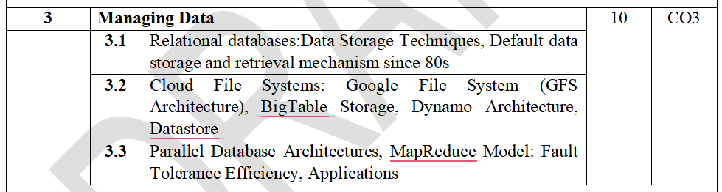
Module 3: Managing Data

Slide 2
Google File System (GFS Architecture)
Google File System (GFS) is a distributed file system developed by Google to efficiently store and process massive amounts of data across thousands of inexpensive commodity servers.
Unlike traditional file systems that run on a single computer, GFS distributes files across many machines, allowing Google services such as Search, Gmail, Google Maps, and YouTube to handle petabytes of data.
Definition
Google File System (GFS) is a scalable distributed file system designed to provide high performance, fault tolerance, and reliability for large-scale data-intensive applications.

Slide 3
Google File System (GFS Architecture)
1.Why Did Google Develop GFS?
Traditional file systems were not designed to handle Google's enormous and rapidly growing data.
Problems with Traditional File Systems:
Limited storage capacity
Single point of failure
Difficult to scale
Poor fault tolerance
High hardware costs
Unable to efficiently process petabytes of data
Google required a system that could:
Store enormous files
Support thousands of servers
Continue operating even if hardware fails
Provide high-speed access
Automatically recover from failures

Slide 4
Google File System (GFS Architecture)
2. Features of GFS
Distributed storage across many servers
High scalability
Fault tolerance through replication
High throughput
Automatic failure recovery
Optimized for large files
Supports concurrent access by many clients

Slide 5
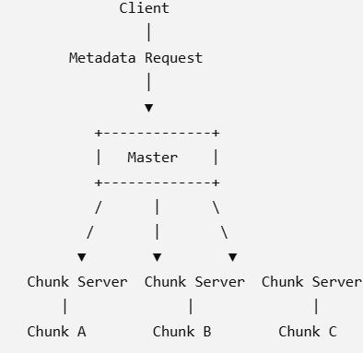
Google File System (GFS Architecture)
3. GFS Architecture
The Google File System consists of three main components:
GFS Client
Master Server
Chunk Servers
Architecture Diagram

Slide 6
Google File System (GFS Architecture)
3. GFS Architecture
Components of GFS
i) GFS Client
The client is the application that accesses files stored in GFS.
Responsibilities:
Requests metadata from the Master.
Communicates directly with Chunk Servers.
Reads and writes data.
Examples:
Google Search
Gmail
Google Maps

Slide 7
Google File System (GFS Architecture)
3. GFS Architecture
Components of GFS
ii) Master Server
The Master is the brain of the GFS.
It does not store actual file data instead, it stores metadata.
Responsibilities
Maintains file names.
Stores directory structure.
Tracks chunk locations.
Controls access permissions.
Monitors Chunk Servers.
Manages replication.
Detects failures.

Slide 8
Google File System (GFS Architecture)
3. GFS Architecture
Components of GFS
ii) Master Server
Metadata Stored by Master
File names
Chunk IDs
Chunk locations
Access permissions
Replication information

Slide 9
Google File System (GFS Architecture)
3. GFS Architecture
Components of GFS
iii) Chunk Servers
Chunk Servers store the actual file data.
Each file is divided into fixed-size chunks.
Each Chunk Server stores many chunks.

Slide 10
Google File System (GFS Architecture)
4. File Storage in GFS
Instead of storing a complete file on one machine, GFS divides it into chunks.
Chunk Size
Each chunk is 64 MB (original GFS design).
Each chunk has a unique Chunk Handle (ID).
Example
Suppose a file is 180 MB.
It is divided into:
Chunk Size
Chunk 1 64 MB
Chunk 2 64 MB
Chunk 3 52 MB
These chunks may be stored on different Chunk Servers.

Slide 11
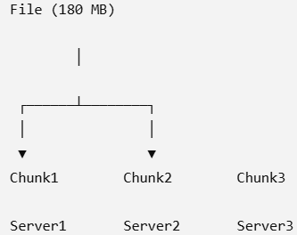
Google File System (GFS Architecture)
4. File Storage in GFS
Instead of storing a complete file on one machine, GFS divides it into chunks.
Chunk Size
Each chunk is 64 MB (original GFS design).
Each chunk has a unique Chunk Handle (ID).
Example
Suppose a file is 180 MB.
It is divided into:
Chunk Size
Chunk 1 64 MB
Chunk 2 64 MB
Chunk 3 52 MB
These chunks may be stored on different Chunk Servers.

Slide 12
Google File System (GFS Architecture)
5. Read Operation in GFS
Step-by-Step Process
Client requests metadata from the Master.
Master returns the Chunk Server locations.
Client directly contacts the Chunk Server.
Chunk Server sends the requested data.
Master is not involved in the actual data transfer.

Slide 13
Google File System (GFS Architecture)
6. Write Operation in GFS
When writing data:
Client requests chunk information from the Master.
Master identifies the Primary Chunk Server.
Client sends data to all replicas.
Primary coordinates the write.
Secondary replicas perform the write.
Confirmation is sent back to the client.

Slide 14
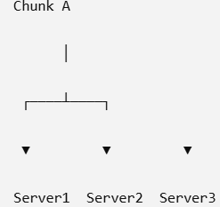
Google File System (GFS Architecture)
7. Replication and Fault Tolerance
Replication
Each chunk is stored on multiple Chunk Servers.
Typically, three copies (replicas) are maintained.
Advantages:
Data remains available even if one server fails.
Improves reliability.
Supports load balancing.

Slide 15
Google File System (GFS Architecture)
7. Replication and Fault Tolerance
Fault Tolerance
If a Chunk Server fails:
The Master detects the failure through heartbeat messages.
Clients are redirected to another replica.
The Master creates a new replica to maintain the desired replication level.
This ensures continuous availability without manual intervention.

Slide 16
Google File System (GFS Architecture)
8. Advantages of GFS
Highly scalable
Handles petabytes of data
High throughput
Low-cost hardware
Automatic recovery from failures
Supports distributed computing
Optimized for large sequential reads and writes
9. Limitations of GFS
Not suitable for many small files
Master Server can become a bottleneck
High network traffic during replication
Primarily optimized for Google's workloads
Not designed for low-latency random access

Slide 17
Google File System (GFS Architecture)
Applications of GFS
GFS is used in applications that process massive amounts of data.
Google uses GFS for:
Examples include:
Search engines
Web indexing
Data analytics
Machine learning
Video storage and streaming
Email services
Cloud storage platforms
Big data processing (e.g., as the storage layer supporting systems like MapReduce)

Slide 18
Google File System (GFS Architecture)
Activity: Storing a Large Video File
Suppose you have a 200 MB video file to store in GFS.
How many chunks will the file be divided into if each chunk is 64 MB?
On how many Chunk Servers will the data be stored if each chunk has three replicas?
What happens if one Chunk Server fails?
Expected Answer:
200 MB ÷ 64 MB = 4 chunks (64 MB, 64 MB, 64 MB, and 8 MB)
Each chunk has 3 replicas, so there are 12 chunk copies distributed across Chunk Servers.
If one Chunk Server fails, the Master redirects requests to another replica and creates a new replica to maintain three copies.

Slide 19
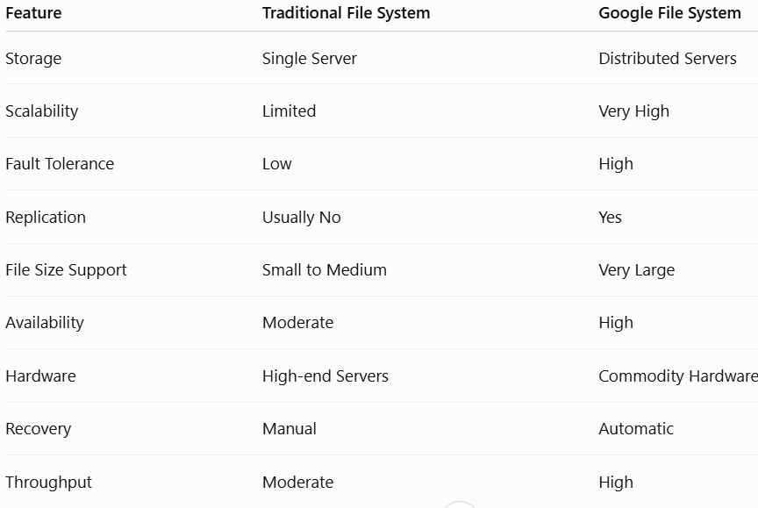
Google File System (GFS Architecture)
Traditional file systems vs GFS

Slide 20
BigTable Storage
Introduction to NoSQL Databases
What is NoSQL?
NoSQL (Not Only SQL) databases are non-relational databases designed to handle very large volumes of structured, semi-structured, and unstructured data.
Unlike traditional relational databases, NoSQL databases provide:
Horizontal scalability
High availability
Fault tolerance
Flexible schema
Faster access to large datasets

Slide 21
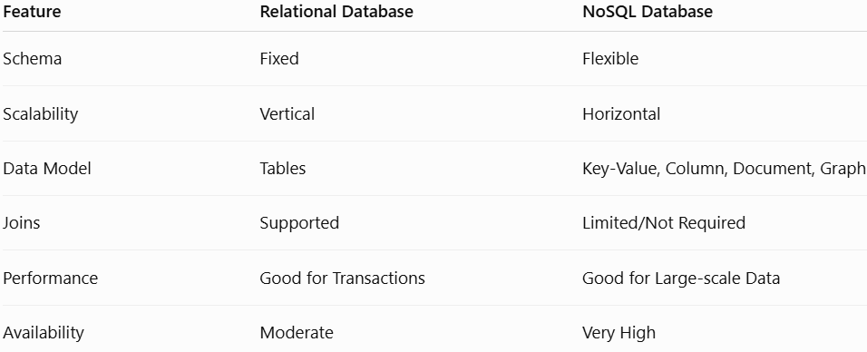
BigTable Storage
Traditional Database vs NoSQL

Slide 22
BigTable Storage
What is BigTable?
Google BigTable is a distributed, scalable, column-family NoSQL database developed by Google to store and manage massive amounts of structured data across thousands of servers.
It is designed for applications requiring:
High scalability
High performance
Low latency
Fault tolerance
BigTable is a distributed, column-family-based NoSQL database designed to store petabytes of structured data across thousands of commodity servers.

Slide 23
BigTable Storage
Features of BigTable:
Distributed architecture
Column-family storage
Automatic partitioning
Dynamic scalability
Fault tolerance
Data replication
High throughput
Sparse data storage
Supports billions of rows

Slide 24
BigTable Storage
Applications
BigTable is used in:
Google Search
Gmail
Google Maps
Google Earth
Google Analytics
YouTube
Google Finance

Slide 25
BigTable Storage
BigTable Data Model
BigTable stores data differently from relational databases.
Instead of rows and fixed columns, BigTable stores data using:
Row Keys
Column Families
Columns
Timestamps

Slide 26
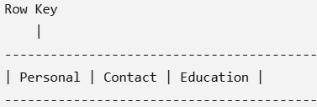
BigTable Storage
Basic Structure
1. Row Key
Every row has a unique identifier called the Row Key.
Example
Row key Student Name
101 Rahul
102 Priya
103 Amit
The Row Key uniquely identifies each row and determines the physical storage order.

Slide 27
BigTable Storage
Basic Structure
1. Row Key
Characteristics of Row Keys
Unique
Sorted lexicographically
Immutable after creation
Efficient for searching

Slide 28
BigTable Storage
2. Column Family
A Column Family is a logical group of related columns.
Example
Student Information
Personal
Name
Age
Contact
Email
Mobile
Education
Degree
CGPA
Examples of Column Families:
Personal
Contact
Education
Salary
Address

Slide 29
BigTable Storage
3. Columns
Columns exist within a column family.
Example
Column Family: Contact
Columns:
Email
Phone Number
Address
Unlike relational databases, different rows can have different columns.

Slide 30
BigTable Storage
Example
Row Email Mobile Address
Rahul Yes Yes No
Priya Yes Yes Yes
Amit Yes No No
This makes BigTable efficient for sparse datasets.

Slide 31
BigTable Storage
4. Timestamp
Each cell stores multiple versions of data.
Each version has a timestamp.
Example
Timestamp Salary
2024 ₹50,000
2025 ₹55,000
2026 ₹60,000
This enables version control and historical data retrieval.

Slide 32
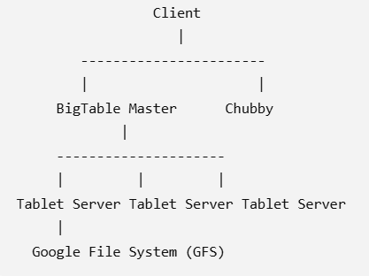
BigTable Storage
BigTable Architecture
BigTable is built on three major Google technologies:
Google File System (GFS)
Chubby
SSTables

Slide 33
BigTable Storage
Components
1. Client
Sends read/write requests.
Communicates with Tablet Servers.
2. BigTable Master
Responsibilities:
Assign tablets to Tablet Servers
Load balancing
Recovery after failures
Monitoring Tablet Servers
The Master does not handle actual data access during normal read/write operations.

Slide 34
BigTable Storage
Components
3. Tablet Server
Stores and manages tablets.
Responsibilities:
Store data
Read data
Write data
Split large tablets
Serve client requests

Slide 35
BigTable Storage
Components
4. Google File System (GFS)
Provides distributed storage for BigTable.
Responsibilities:
Store SSTable files
Replication
Fault tolerance
Large-scale storage

Slide 36
BigTable Storage
Components
5. Chubby
Chubby is Google's distributed lock service.
Responsibilities:
Master election
Synchronization
Metadata management
Failure detection

Slide 37
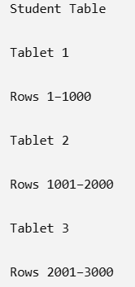
BigTable Storage
Components
5. Tablets and SSTables
What is a Tablet?
A Tablet is a horizontal partition of a BigTable.
Large tables are divided into smaller tablets.
Example
Advantages:
Parallel processing
Load balancing
Easy scalability

Slide 38
BigTable Storage
What is an SSTable?
SSTable (Sorted String Table) is the storage format used by BigTable.
Characteristics:
Immutable file
Sorted by Row Key
Fast searching
Efficient storage

Slide 39
BigTable Storage
What is an SSTable?
SSTable (Sorted String Table) is the storage format used by BigTable.
Characteristics:
Immutable file
Sorted by Row Key
Fast searching
Efficient storage
Benefits of SSTables
Faster reads
Efficient indexing
Better compression
High performance

Slide 40
BigTable Storage
Read and Write Operations
Read Operation
Client sends a read request.
Tablet Server locates the row.
Data is fetched from the appropriate SSTable.
The result is returned to the client.
Write Operation
Client sends a write request.
Data is first written to a commit log for durability.
The data is stored in an in-memory structure (MemTable).
When the MemTable becomes full, it is flushed to disk as a new SSTable.
Background compaction merges multiple SSTables to improve performance.

Slide 41
BigTable Storage
Advantages of BigTable
Highly scalable
High performance
Supports billions of rows
Fault tolerant
Automatic load balancing
Distributed storage
Efficient for sparse datasets
Handles massive data volumes
Flexible schema

Slide 42
BigTable Storage
Limitations of BigTable
No support for complex SQL joins
Limited transaction support compared to relational databases
Complex architecture
Optimized for Google's infrastructure
Not suitable for applications requiring complex relational queries

Slide 43
BigTable Storage
Applications of BigTable
BigTable is used in:
Google Search indexing
Gmail mailbox storage
Google Maps location data
Google Earth
YouTube metadata
Google Analytics
Machine Learning datasets
Internet of Things (IoT)
Real-time analytics
Large-scale logging systems

Slide 44
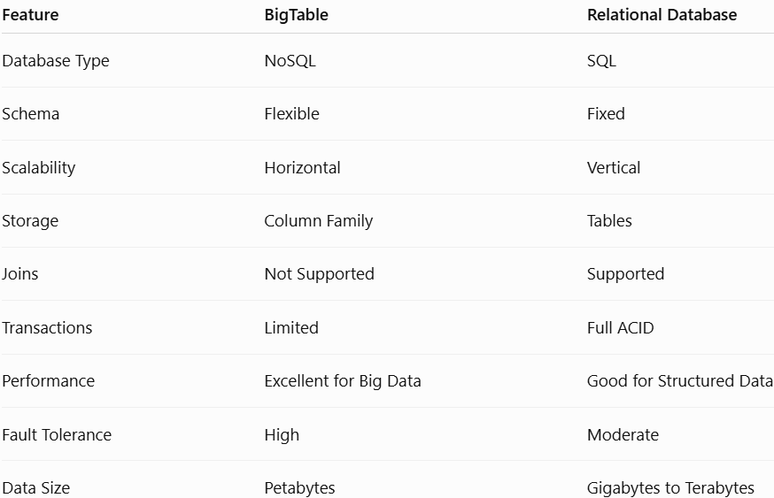
BigTable Storage
BigTable vs Relational Database

Slide 45
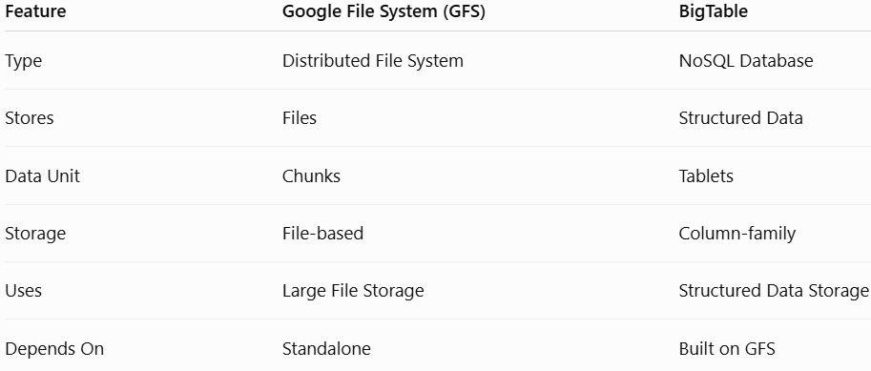
BigTable Storage
BigTable vs GFS

Slide 46
Dynamo Architecture
Introduction to Dynamo
Amazon’s highly available distributed key-value storage system.
Dynamo is a distributed data storage system originally developed by Amazon for applications that require:
Very high availability
High scalability
Low latency
Fault tolerance
Continuous operation even when some servers fail
It was designed particularly for services such as:
Shopping carts
Product catalogs
Customer preferences
Session information
It is better to remain available and accept temporary inconsistencies than to become unavailable during failures.

Slide 47
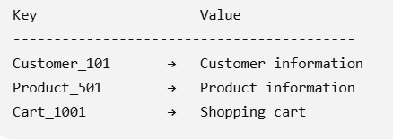
Dynamo Architecture
Basic idea
Dynamo follows a key-value data model:
Instead of storing data in tables with complex relationships, data is accessed using a key.

Slide 48
Dynamo Architecture
Why Do We Need Dynamo?
Traditional relational databases can become difficult to scale when applications require:
Millions of users
Large numbers of requests
Continuous availability
Geographically distributed servers
Very low response time
For example, consider an online shopping application.
During a major sale:
Millions of users
↓
Millions of requests
↓
Distributed servers
↓
Distributed storage

Slide 49
Dynamo Architecture
Why Do We Need Dynamo?
Traditional databases generally use centralized or strongly consistent architectures.
Imagine Amazon has millions of customers accessing a shopping cart.
A user might perform:
Add Laptop → Shopping Cart
At the same time:
Server A → failure
Server B → available
Server C → available
If the system depended on Server A, the shopping cart service could become unavailable.

Slide 50
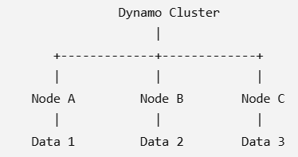
Dynamo Architecture
Why Do We Need Dynamo?
Dynamo instead distributes the data across multiple machines.
Copies of important data can also exist on multiple nodes.

Slide 51
Dynamo Architecture
Why Do We Need Dynamo?
A failure of one server should not make the entire application unavailable.
Therefore, Dynamo uses:
Data partitioning
Replication
Distributed nodes
Failure detection
Recovery mechanisms

Slide 52
Dynamo Architecture
Characteristics of Dynamo
The important characteristics are:
3.1 Distributed
Data is distributed across multiple nodes.
3.2 Decentralized
There is no single central database server responsible for all operations.
3.3 Highly Available
The system attempts to continue serving requests even when nodes fail.

Slide 53
Dynamo Architecture
Characteristics of Dynamo
3.4 Fault Tolerant
Failure of individual machines should not bring down the entire system.
Failures can include:
Disk failure
Server failure
Network failure
Software failure
Power failure
Node becoming temporarily unavailable
Data is therefore replicated.
3.5 Scalable
Additional nodes can be added to increase capacity.
3.6 Eventually Consistent
All replicas may not immediately contain the same value, but they are designed to converge when updates stop

Slide 54
Dynamo Architecture
Dynamo Data Model
Dynamo uses a simple key-value model.
Key → Object/Value
For example:
User101 → {
Name: "John",
Cart: "Product101, Product205"
}
Another example:
Product1001 → {
Name: "Laptop",
Price: 65000
}

Slide 55
Dynamo Architecture
Dynamo Data Model
Characteristics
Simple data model
Schema flexibility
Fast key-based access
Suitable for distributed applications
No complex joins

Slide 56
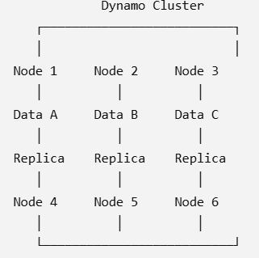
Dynamo Architecture
Basic Dynamo Architecture
Dynamo consists of multiple distributed nodes.
Each node is responsible for a portion of the data.

Slide 57
Dynamo Architecture
The major mechanisms are:
Partitioning
Replication
Consistency
Versioning
Failure handling
Membership management

Slide 58
Dynamo Architecture
Consistent Hashing
One of the most important concepts in Dynamo is consistent hashing.
It is used to determine:
Which node should store a particular key?
Traditional hashing problem:
Suppose there are four servers:
Server 1
Server 2
Server 3
Server 4
hash(key) % number_of_servers
and one server is added or removed, many keys may have to be redistributed.
This creates significant data movement.

Slide 59
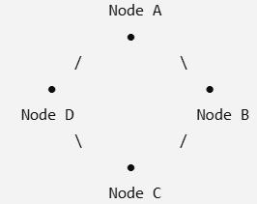
Dynamo Architecture
Consistent Hashing Concept
Consistent hashing arranges nodes on a logical hash ring.
Both: Data keys,Server nodes are mapped onto the same hash space.
Data placement
Suppose: hash(Key1) → position on ring
The key is assigned to the appropriate node according to the hashing scheme.
This allows Dynamo to distribute data across multiple nodes.

Slide 60
Dynamo Architecture
Advantages of Consistent Hashing
1. Scalability
New servers can be added without redistributing all data.
2. Fault tolerance
If a server fails, its data can be handled by neighboring/replica nodes.
3. Reduced data movement
Only a portion of the data needs to be redistributed.
4. Dynamic membership
Nodes can:
Join
Leave
Fail
Recover
without stopping the entire system.

Slide 61
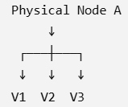
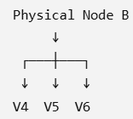
Dynamo Architecture
Virtual Nodes
A major improvement in Dynamo is the use of virtual nodes, often called vnodes.
Instead of assigning one position on the hash ring to each physical server, a physical server can own multiple positions.
Another server:

Slide 62
Dynamo Architecture
Why virtual nodes?
They provide:
Better load balancing
Easier node addition
Easier node removal
Better failure recovery
More uniform data distribution

Slide 63
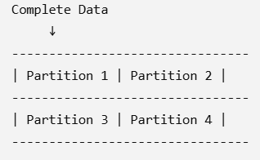
Dynamo Architecture
Data Partitioning
Dynamo divides the complete data space into partitions.
For example:
Each partition is assigned to one or more nodes.
Example
Suppose there are:
1 million keys
and four nodes:
Node A → 250,000 keys
Node B → 250,000 keys
Node C → 250,000 keys
Node D → 250,000 keys This distributes the workload.

Slide 64
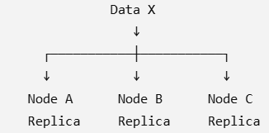
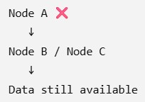
Dynamo Architecture
Replication
Dynamo does not store only one copy of important data.
Instead, it creates multiple replicas.
Suppose: Replication factor = 3
Then:
If Node A fails:

Slide 65
Dynamo Architecture
Benefits
High availability
Fault tolerance
Data durability
Reduced risk of data loss

Slide 66
Dynamo Architecture
Replication Factor
The replication factor (N) represents the number of copies of data maintained.
For example: N=3
means three replicas.
If:N=5
then five replicas are maintained.
Higher replication can improve availability but increases:
Storage requirements
Network traffic
Synchronization overhead

Slide 67
Dynamo Architecture
Consistency in Dynamo
One important challenge in distributed databases is:
How do we ensure that different replicas have consistent data?
Consider:
Node A → Price = ₹50
Node B → Price = ₹50
Node C → Price = ₹50
A client updates the price: ₹50 → ₹60
During the update, some nodes may temporarily contain:
Node A → ₹60
Node B → ₹60
Node C → ₹50
This creates a temporary inconsistency.
Dynamo therefore uses an eventual consistency approach.

Slide 68
Dynamo Architecture
Eventual Consistency
Eventual consistency means:
If no new updates are made, all replicas will eventually converge to the same value.
Example:
Initially:
A → ₹50
B → ₹50
C → ₹50
After update:
A → ₹60
B → ₹60
C → ₹50
After synchronization:
A → ₹60
B → ₹60
C → ₹60
Thus, replicas eventually become consistent.

Slide 69
Dynamo Architecture
Eventual Consistency
Advantage
It provides:
High availability
Low latency
Better scalability
Disadvantage
Different users may temporarily observe different versions of data.

Slide 70
Dynamo Architecture
Quorum-Based Operations
Dynamo uses configurable parameters such as:
N = number of replicas
R = number of replicas that must respond to a read
W = number of replicas that must acknowledge a write
A commonly discussed condition is: R + W > N
This can provide stronger read-after-write overlap because at least one replica participates in both the read and write sets.
Example :Suppose:
N = 3
R = 2
W = 2
Then:
R + W = 4
4 > 3
Therefore, the read and write sets overlap.

Slide 71
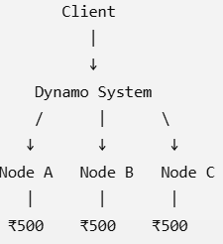
Dynamo Architecture
Read Operation
Suppose the client requests:
GET Product101
The request goes to the appropriate Dynamo nodes.
If R=2
the system may wait for responses from two replicas before returning the result.

Slide 72
Dynamo Architecture
Failure Handling
Failure is expected in a distributed system.
Possible failures include:
Server failure
Network failure
Disk failure
Communication failure
Temporary node unavailability
Dynamo is designed to continue operating even when some nodes fail.

Slide 73
Dynamo Architecture
Failure Detection
Dynamo uses mechanisms to identify failed or unreachable nodes.
For example:
Node A → Working
Node B → Working
Node C → Failed ❌
The system detects:
Node C is unavailable
and can redirect operations to other replicas.

Slide 74
Dynamo Architecture
Hinted Handoff
Hinted handoff is used to maintain availability when the intended replica node is temporarily unavailable.
Suppose: Data X should be stored on Node C
but: Node C ❌
Another node can temporarily store the data.
Node A → Data X
Node B → Data X
Node C → ❌
Node D → Temporary copy
When Node C recovers:
Node D → sends data → Node C
This is called hinted handoff.

Slide 75
Dynamo Architecture
Versioning and Conflict Resolution
Because multiple replicas may receive updates independently, conflicts can occur.
Example:
User 1 → modifies shopping cart
User 2 → modifies shopping cart
Different replicas may contain different versions.
Dynamo uses version information to identify relationships between versions.
A commonly discussed mechanism is vector clocks.
Vector Clock
It helps determine whether:
One version is newer than another
Two versions are independent/conflicting

Slide 76
Dynamo Architecture
Versioning and Conflict Resolution
Example:
Version 1 → [A:1]
Version 2 → [A:2]
Version 2 is derived from Version 1.
But:
Version 1 → [A:1]
Version 2 → [B:1]
may indicate concurrent updates that need conflict resolution.

Slide 77
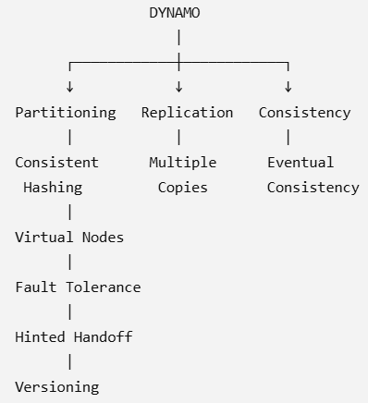
Dynamo Architecture
Dynamo Architecture
The major mechanisms can be remembered as:

Slide 78
Datastore
Datastore
In cloud computing, a datastore is a storage system used to store, organize, manage, and retrieve data in a cloud environment. Unlike traditional local storage, a cloud datastore is designed to provide scalability, availability, reliability, accessibility, and fault tolerance over the network.
A datastore can store many types of information, such as:
Customer records
Student information
Product catalogs
Transaction records
Images and videos
Application logs
Sensor/IoT data
User sessions
Documents and files

Slide 79
Datastore
Datastore
What is Datastore?
Datastore generally refers to a distributed NoSQL data storage service. In the Google Cloud context, Cloud Datastore is a highly scalable NoSQL database service, now provided as Firestore in Datastore mode.
Google Cloud's managed NoSQL database, historically known as Google App Engine Datastore and now part of Firestore in Datastore mode.
It is designed for applications that need:
Scalable storage
Automatic replication
High availability
Flexible data structures
Distributed access

Slide 80
Datastore
Why Do We Need Datastores in Cloud Computing?
Traditional applications often store data on a server's local hard disk.
For example:
Application Server
│
↓
Local Disk
│
↓
Data
This creates several problems.

Slide 81
Datastore
Why Do We Need Datastores in Cloud Computing?
Problem 1: Limited storage
A physical server has a limited amount of disk space.
For example:
Server storage = 1 TB
If the application grows and needs 10 TB, the organization must add or replace storage.

Slide 82
Datastore
Why Do We Need Datastores in Cloud Computing?
Problem 2: Server failure
If the server fails:
Server failure
↓
Application unavailable
↓
Data may become inaccessible
Cloud datastores address this through replication and redundancy.

Slide 83
Datastore
Why Do We Need Datastores in Cloud Computing?
Problem 3: Increasing number of users
Suppose an application has:
Day 1 → 1,000 users
Month 1 → 10,000 users
Month 6 → 1,000,000 users
The datastore must handle increasing amounts of data and requests.
Cloud datastores can generally scale horizontally or vertically depending on the service.

Slide 84
Datastore
Why Do We Need Datastores in Cloud Computing?
Problem 4: Global access
Cloud applications may have users from different geographical locations.
A cloud datastore can be designed to support access from:
India ───────┐
USA ─────────┤
Europe ──────┼──→ Cloud Datastore
Singapore ───┤
Australia ───┘

Slide 85
Datastore
Characteristics of a Cloud Datastore
A good cloud datastore generally provides the following characteristics.
3.1 Scalability
Scalability means the datastore can handle increasing amounts of:
Data
Users
Requests
Transactions
There are two major approaches.
Vertical scaling
Increase the power of an existing server.

Slide 86
Datastore
Characteristics of a Cloud Datastore
Vertical scaling:
Increase the power of an existing server.
Small Server
CPU: 4 cores
RAM: 16 GB
↓
Large Server
CPU: 32 cores
RAM: 128 GB
Horizontal scaling:
Add more machines.
Datastore
/ | \
/ | \
Server Server Server
1 2 3
Cloud-native datastores often use horizontal scaling to support very large workloads.

Slide 87
Datastore
Characteristics of a Cloud Datastore
2. Availability
Availability means the datastore remains accessible when applications need it.
Suppose one physical machine fails:
Datastore
/ \
Server A Server B
X ✓
Failed Working
The application can continue using Server B.
Cloud providers typically achieve this using redundancy, replication, and multiple availability zones.

Slide 88
Datastore
3. Durability
Durability means data should not be lost after it has been successfully stored.
For example:
Original data
↓
Replica 1
Replica 2
Replica 3
If one copy is lost, other copies can preserve the data.

Slide 89
Datastore
4. Fault Tolerance
A cloud datastore should continue functioning even when some components fail.
Possible failures include:
Server failure
Disk failure
Network failure
Software failure
Availability Zone failure
Example: Cloud Datastore
│
┌───────────┼───────────┐
↓ ↓ ↓
AZ-1 AZ-2 AZ-3
│ │ │
Data A Data A Data A
If AZ-1 fails, the application can potentially access the replicas in AZ-2 or AZ-3.

Slide 90
Datastore
5.Data Persistence
A datastore provides persistent storage.
Persistent data remains available even after:
Application shutdown
Server restart
VM restart
Container restart
For example:
Application
↓
Datastore
↓
Student records

Slide 91
Datastore
5.Data Persistence
If the application crashes:
Application crashes
↓
Datastore remains
↓
Student records preserved
This is particularly important in cloud-native applications where application instances may frequently be created and destroyed.

Slide 92
Datastore
Types of Datastores in Cloud Computing
Cloud computing supports several types of datastores.
The major categories are:
Relational databases
Key-value stores
Document databases
Column-family databases
Graph databases
Object storage
File storage
Block storage
In-memory datastores

Slide 93
Datastore
Datastore
What is Datastore?
Historically, it was strongly associated with Google App Engine.
Today, Google Cloud's Datastore functionality is offered through Firestore in Datastore mode.

Slide 94
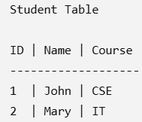
Datastore
Datastore Data Model
Datastore does not organize data primarily as relational tables.
Traditional relational databases use:
Table
↓
Rows
↓
Columns
It uses concepts such as:
Entities
Kinds
Properties
Keys
Relational database

Slide 95
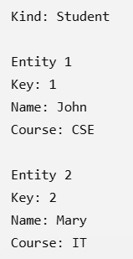
Datastore
Datastore Data Model
Datastore
The basic structure is:
Kind
|
+--- Entity
|
+--- Properties

Slide 96
Datastore
Entity
An entity is an individual object stored in Datastore.
Example:
Student
{
studentId: 101,
name: "Rahul",
course: "CSE",
age: 20
}
Another entity:
Student
{
studentId: 102,
name: "Priya",
course: "IT",
age: 21
}

Slide 97
Datastore
Kind
A kind groups similar entities.
For example:
Student
├── Entity 101
├── Entity 102
└── Entity 103
Teacher
├── Entity 201
└── Entity 202
So:
Kind = Student
means that the entities belong to the Student category.

Slide 98
Datastore
Properties
Properties store information about an entity.
Example: Student
----------------
studentId → 101
name → Rahul
course → CSE
age → 20
Unlike a traditional relational table, entities in the same kind can have different properties.
For example: Student 101:
name
course
age
Student 102:
name
course
age
email
This represents a more flexible schema.

Slide 99
Datastore
Keys in Datastore
Each entity needs a unique identity.
A key can contain:
Kind + ID
For example:
Student + 101
or a string name/key.
Conceptually:
Key
|
+--- Kind = Student
|
+--- ID = 101
The key uniquely identifies the entity.

Slide 100
Datastore
Hierarchical / Ancestor Relationships
Datastore can organize entities into hierarchical relationships.
For example:
University
|
+--- Department
|
+--- Student
Example:
University/ABC
|
+--- Department/CSE
|
+--- Student/101
+--- Student/102
This is called an ancestor relationship.

Slide 101
Datastore
Indexing
Datastore uses indexes to make queries efficient.
Suppose you want:
Find all students where
course = "CSE"
An index can help Datastore locate the matching entities efficiently.
Conceptually:
Student entities
|
v
Index
|
v
Course = CSE
|
+--- Student 101
+--- Student 105
+--- Student 109

Slide 102
Datastore
Indexing
Datastore uses indexes to make queries efficient.
Suppose you want:
Find all students where course = "CSE"
An index can help Datastore locate the matching entities efficiently.
Conceptually:
Student entities
|
v
Index
|
v
Course = CSE
|
+--- Student 101
+--- Student 105
+--- Student 109
Indexes are extremely important in Datastore because many queries depend on them.

Slide 103
Datastore
Queries in Datastore
You can query entities based on properties.
For example:
Kind = Student
WHERE course = "CSE"
The database finds students belonging to CSE.
Other examples:
age > 20
or:
course = "CSE"
AND age > 20

Slide 104
Datastore
Transactions
Datastore supports transactions for operations that need atomicity.
For example:
Read student's marks
↓
Update total marks
↓
Update result
If an operation fails, the transaction can prevent an incomplete update.
Transactions are particularly important for maintaining consistency among related entities.

Slide 105
Datastore
Transactions
Datastore supports transactions for operations that need atomicity.
For example:
Read student's marks
↓
Update total marks
↓
Update result
If an operation fails, the transaction can prevent an incomplete update.
Transactions are particularly important for maintaining consistency among related entities.

Slide 106
Datastore
Strong and Eventual Consistency
Datastore historically provided different consistency behavior depending on the type of operation/query.
A simplified distinction is:
Strong consistency
The read sees the latest committed data.
Write
↓
Read
↓
Latest value

Slide 107
Datastore
Eventual consistency
A read may temporarily see an older value.
Write
↓
Replica synchronization
↓
Latest value eventually visible
This is a common concept in distributed databases.

Slide 108
Datastore
Datastore Architecture
Application
|
v
Datastore API
|
+--------+--------+
| |
v v
Entity Store Indexes
| |
+--------+--------+
|
v
Distributed Storage
/ | \
/ | \
Node A Node B Node C
\ | /
\ | /
Replication

Slide 109
Datastore
Relational database vs Datastore
Relational Database | Datastore
SQL database | NoSQL database
Tables | Kinds
Rows | Entities
Columns | Properties
Fixed/structured schema | Flexible schema
SQL queries | Datastore query mechanisms
Joins commonly supported | Avoids traditional joins
Vertical scaling traditionally common | Designed for distributed horizontal scaling
Relational model | Document/entity model
Foreign keys commonly used | Key/ancestor relationships
Schema changes can be significant | Flexible entity structure

Slide 110
Datastore
Dynamo vs Datastore:
Feature | Dynamo | Google Datastore
Developed by | Amazon | Google
Type | Distributed key-value store | NoSQL document/entity database
Main data model | Key → Value | Kind → Entity → Properties
Major focus | Very high availability | Scalable application database
Consistency | Primarily eventual consistency | Supports different consistency guarantees
Partitioning | Consistent hashing | Distributed automatically
Replication | Yes | Yes
Failure handling | Sloppy quorum, hinted handoff | Managed by Google
Version handling | Vector clocks | Managed database mechanisms
Query model | Primarily key-based | Property-based queries and indexes
Typical historical use | Amazon internal services | Google App Engine applications

Slide 111
Datastore
One Simple Real-Life Example
Imagine an online shopping website.
A customer adds:
iPhone
to their shopping cart.
Step 1 – Key
Customer ID = C101
Step 2 – Hash
hash(C101)
determines where the data belongs.

Slide 112
Datastore
Step 3 – Replication
The cart is stored on:
Node A
Node B
Node C
Step 4 – Node failure
Suppose:
Node B ❌
The system can still use:
Node A ✓
Node C ✓
Step 5 – Temporary alternative
If a preferred replica is unavailable, another node can temporarily store the data using hinted handoff.

Slide 113
Datastore
Step 6 – Recovery
When the failed node returns:
Temporary node
↓
Hinted handoff
↓
Recovered node
Step 7 – Synchronization
Replicas eventually become consistent.
This entire process demonstrates why Dynamo is suitable for highly available cloud applications.

